Slide 1


TISRA Bot :)
Future Forum Police
Professor:
Course:
Team Member:
Gustavo Sandoval
CS-UY 4563
Michael Li
Kaixuan Zhou

Slide 2
Problem Statement
Build a multiclass classifier for the following types:
Toxic, Informational, Religious, Sports, Advertisement, Neutral

Slide 3
Data Gathering
Manually labelled ~ 1.5k data
Identified Twitter accounts ~ 100 accounts
Classified category for each Twitter account
Tweepy - Twitter API
Obtained latest 200 tweets per account
~20k tweets
Kaggle Toxic Comment Classification Challenge
~2k toxic tweets

Slide 4
Example Classification:
Twitter Accounts | Label
ScienceNews | Information
NASA | Information
SportsNation | Sports
ReviewReligions | Religious
overtimedeals | Advertisement

Slide 5
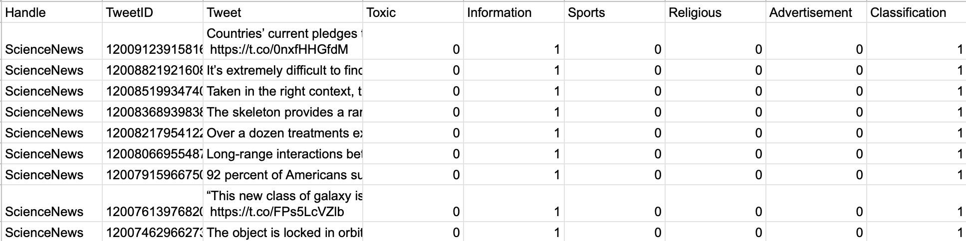
Sample Output

Slide 6
Distribution of Labelled Data
Advertisement:
Information:
Religious:
Sports:
Toxic:
Total:
4741
4799
6653
3398
1922
21,513

Slide 7
Training Procedure

Slide 8
Raw Tweet
TFIDF Vectorizer
:Toxic
:Information
:Religious
:Sports
:Advertisement
Repeat the following process for
Logistic Regression, SVM, and Neural Network

Slide 9
Result Evaluation

Slide 10
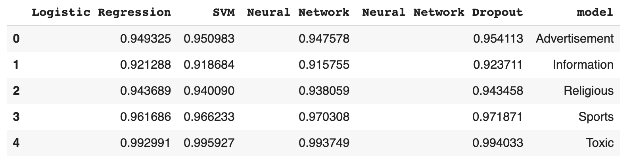

Slide 11
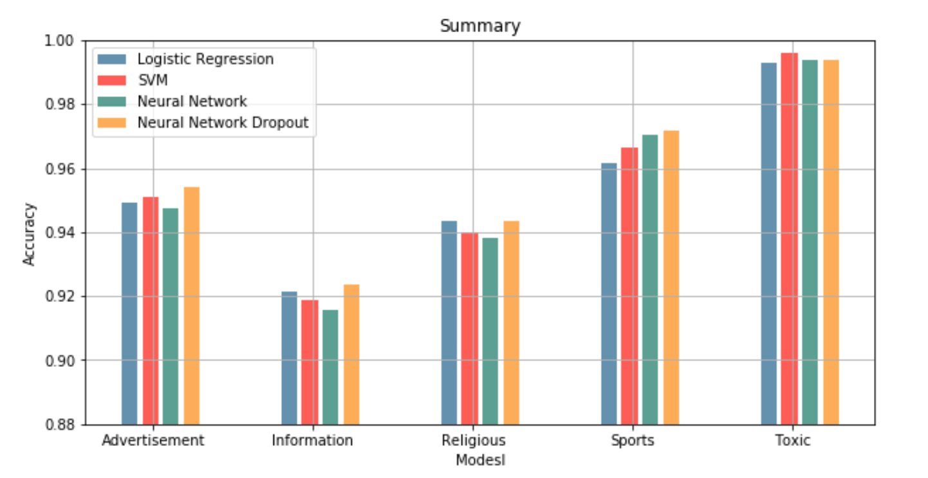

Slide 12
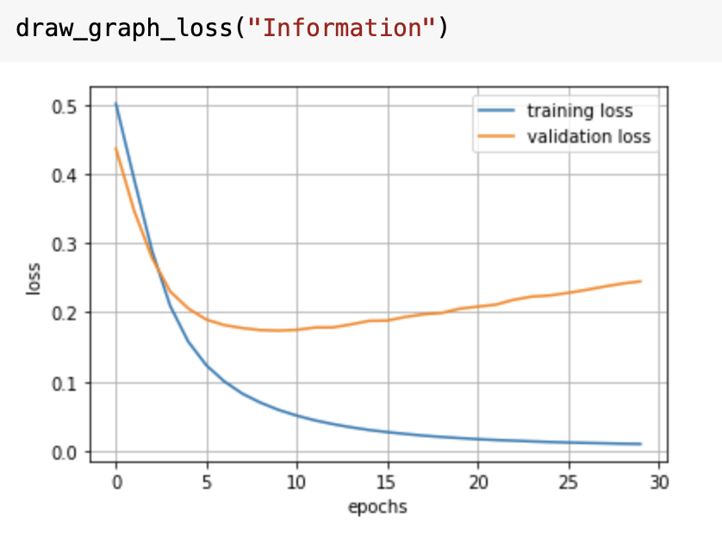
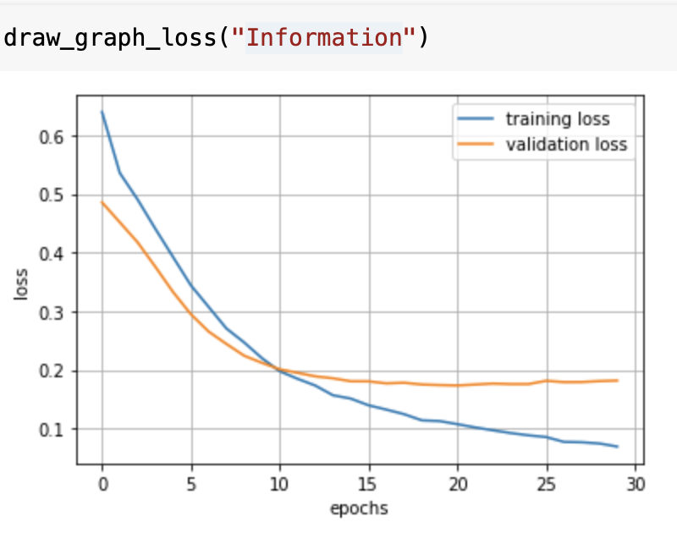
NN: Information Model
No Dropout
Dropout
Appears that NN is overfitting -> Dropout

Slide 13
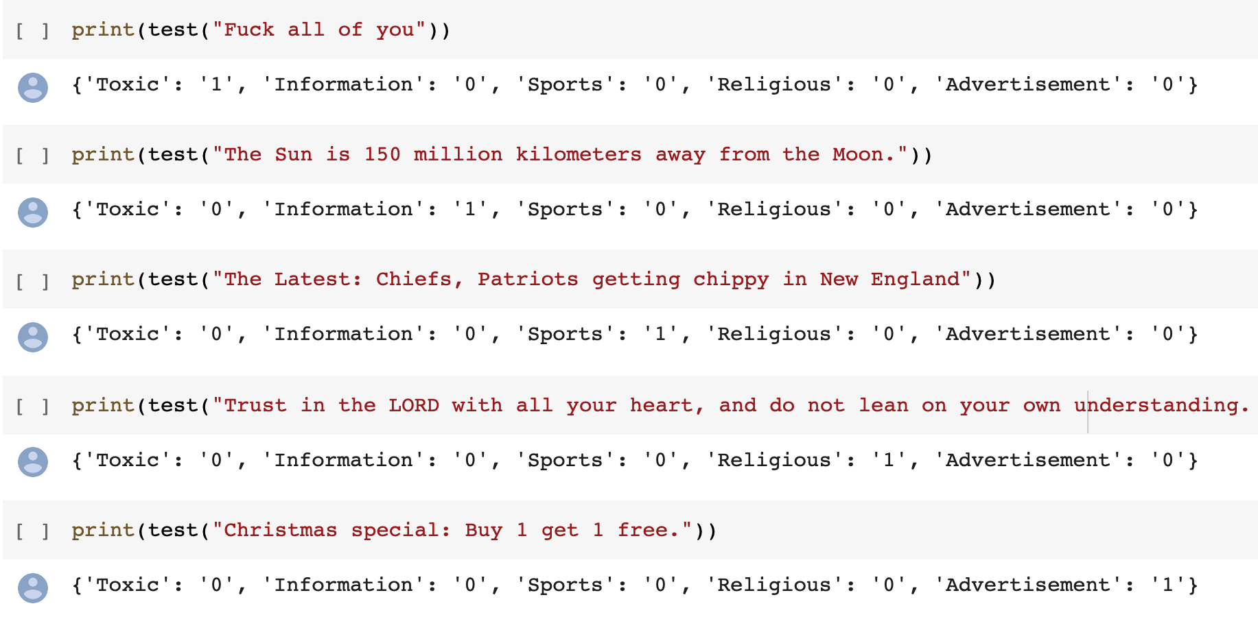

Slide 14
Conclusion

Slide 15
Conclusion
Short text classifier is plausible
Social Media Platforms
Auto-Moderators: Piazza, Twitch, etc.
Good Data labeling: Very Important
Sufficient Data: Very Important
Although we have around 95% accuracy, when we do some testing outside the dataset, it’s not performing like it’s 95% accurate.
Having a dropout layer performs better than no dropout layer
Even when adding dropout, we still might overfit.
Need to retrain the model using KFold Validation to find the best parameter

